Slide 1
INSURANCE POLICY MANAGEMENT
GROUP 4

Slide 2
Team Members
Employee Id | Name
2483887 | Gadhe Hariharan
2487081 | Harni K
2485551 | Jakkamputi Vinay Kumar
2487204 | Jaya Siva Saibhanu Gandikota
2487531 | Jayanisha
2482287 | K B N Phanijagan mohan
2485202 | Kalaiyarasi JG
2486521 | Kamesh V
2487243 | Kaustabh Nagvekar
2484872 | Keerthana Lokeshkumar

Slide 3
INDEX
Introduction
Project Overview
Tools Used
ER Diagram
Admin Module
User Module
Screenshots
Conclusion

Slide 4
INTRODUCTION
The insurance company needs to keep track of details of its policyholders, their policy details and the data available with it. It is very difficult to handle bulk data since human memory is not enough and also paper work consumes lot of time. The Insurance management system is a complete solution, which will be able to manage insurance policies.
In this system, User can purchase insurance policy according to their need. For purchase plan user has to register in system. After registration user can purchase insurance plan based on price and conditions, which helps the customers to compare various plans.
Admin panel contains add-edit categories, policies, and also can approve and reject the policies.

Slide 5
PROJECT OVERVIEW
This project “Insurance Policy Management” makes the task faster and easy. This is used to manage records.
The system is used to keep the record of policy details, customers details.
Insurable Interest
Contribution
Proximate cause
Policy insurance

Slide 6




TOOLS USED
Front end: Angular
Server Side: Spring Boot
Back-end: Hybernate/ MY SQL
Server: Tomcat

Slide 7

Login/Create Account
View/Update/Delete Policy
Approve Policy
User
Admin
View Policy
Apply Policy

Slide 8
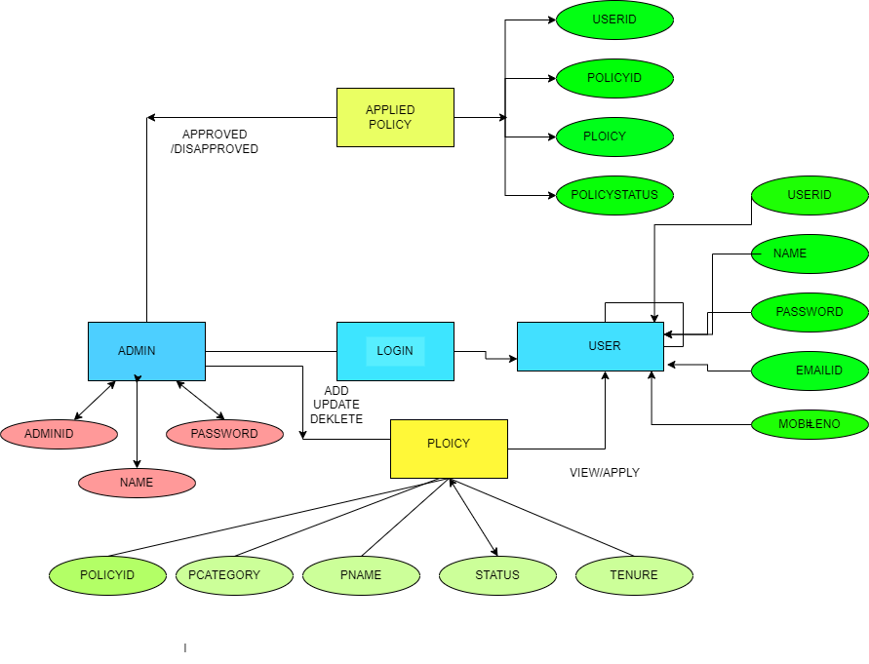

Slide 9
Modules
ADMIN
USER

Slide 10


ADMIN MODULE
Create Account and Login in to portal
View Customers.
View/Add/Update/Delete policy category like Life, Health, vehicle ,fire .
View/Add/Update/Delete policy.
Approve/Disapprove policy, applied by customer.
View total policy holder, approved policy holder, disapproved policy holder.

Slide 11
USER MODULE
Create Account.
Login.
Password.
Update Personal details.
View policy and apply
Raise queries.

Slide 12
EXISTING SYSTEM
The existing system is the manual system. The manual system is prone to error. It is time-consuming. It is very difficult for a person to produce a report. There are chances for changing the scheme report and do malpractice. This system involves a lot of manual entries with the applications to perform the desired task. Usage of papers in the payment process leads to less efficiency, less accuracy and less productivity.
Increasing expenditure for papers shuffling and storage.
Less control of Amounts.
The time delay between the payment and its receipt.
Persons who are present in a different part of the world cannot transact efficiently.
Self service
Take service through agents
Take service online

Slide 13
PROPOSED SYSTEM
The proposed system is designed to eliminate the drawbacks of the existing system. It is designed by keeping to eliminate the drawbacks of the present system to provide a permanent solution to the problems. The primary aim of the new system is to speed up transactions. The report is prepared for the schemes and implemented by the concerned officials.
Since the advent of Online Insurance services in the Middle Ages Policy Agents and policy Holders have used paper-based instruments to move money between Insurance transactions. It comes as no surprise to one that when everything is being converted to computerize.
Already the business has to global with the coming of the Internet. Now, no more the individual aims at the local market are also just a click of a button away. Dozens of companies are in the race to convince auction and bidding that a pot of policies awaits those who conduct their business on the Internet.
In this fast race of business and moneymaking, no country, no company and no individual want to fall back. Everyone wants to lead the group. Hence, everyone is trying to make the best use of the Internet.

Slide 14
FUTURE SCOPE
Developed to be used by the all the people
Can be used by the students for study purpose.
It eradicates the fake policy providing websites.
Keeps the capability to centralize all the insurance industry in India and shall keep transparency in industry.
This project can bring a revolution in the insurance industry.

Slide 15
CONCLUSION
By the implementation of this website, there shall be a transparency in the field of insurance industry and will help in the centralization of the insurance taking policies. There has to be a control over the money invested but the insurance companies in a huge diversity like India. If such system is implemented it could result in various helps to the public as well as the governmental body for the development of the country.

Slide 16
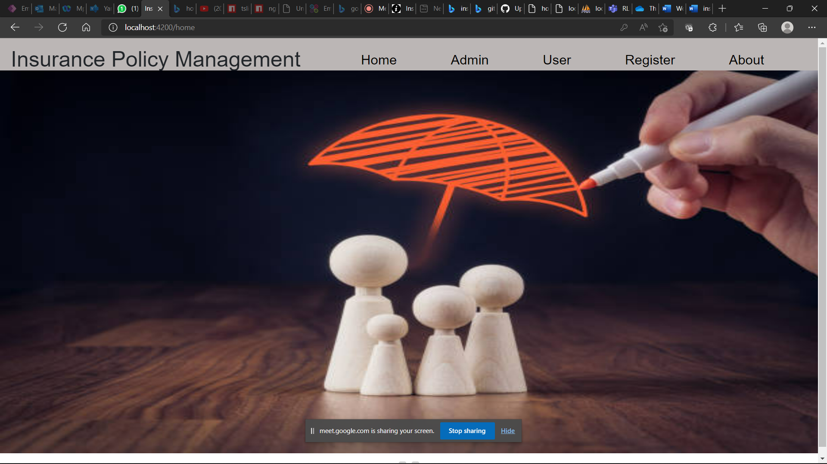
OUTPUTS

Slide 17
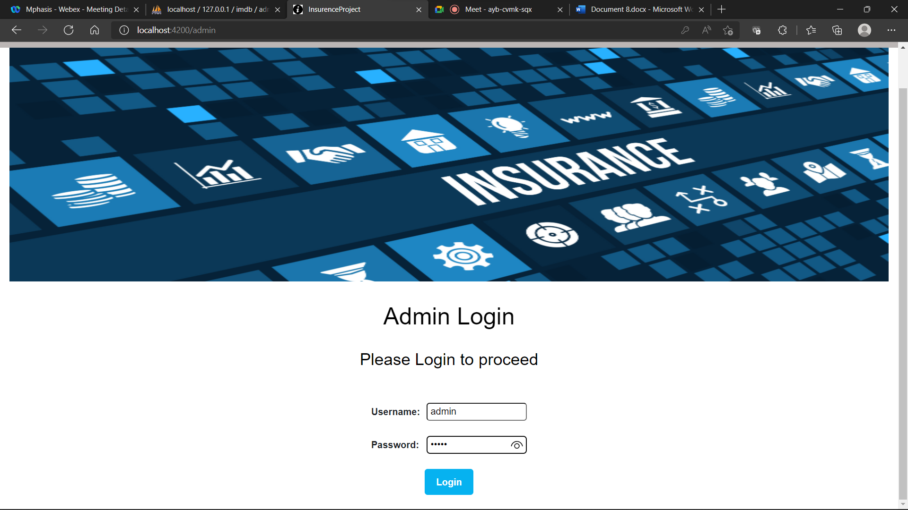

Slide 18
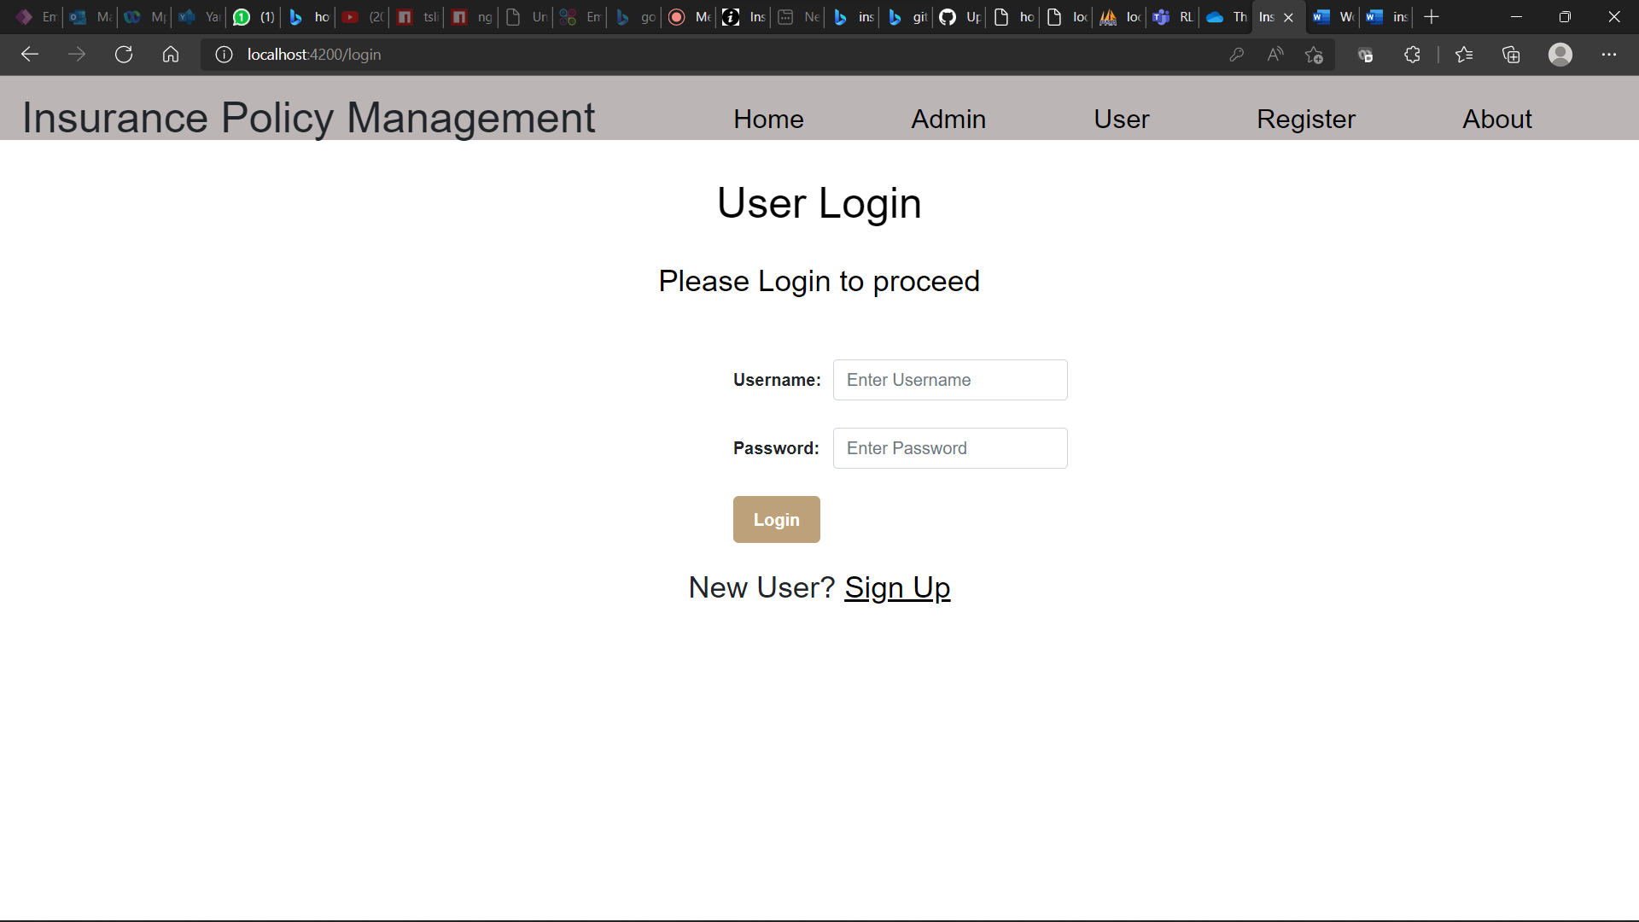

Slide 19
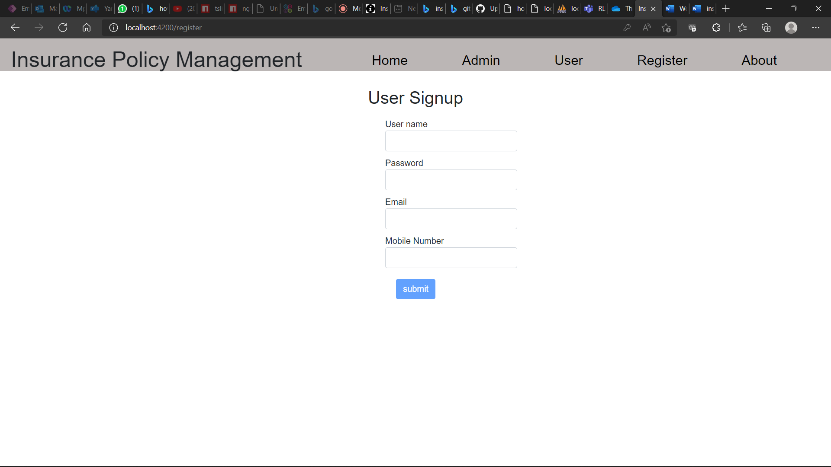

Slide 20
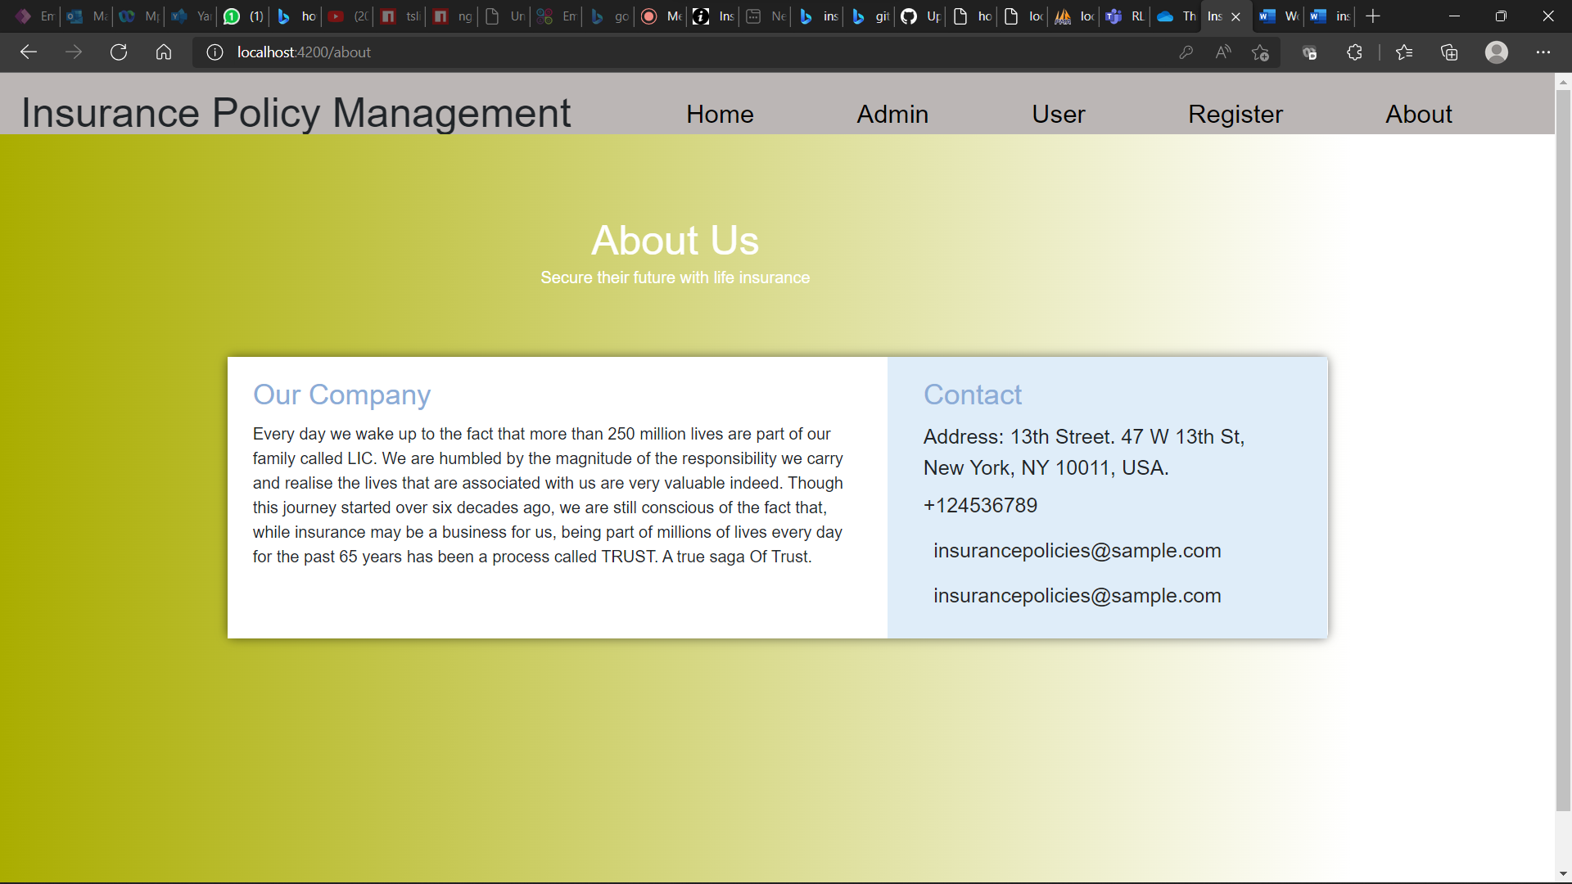

Slide 21
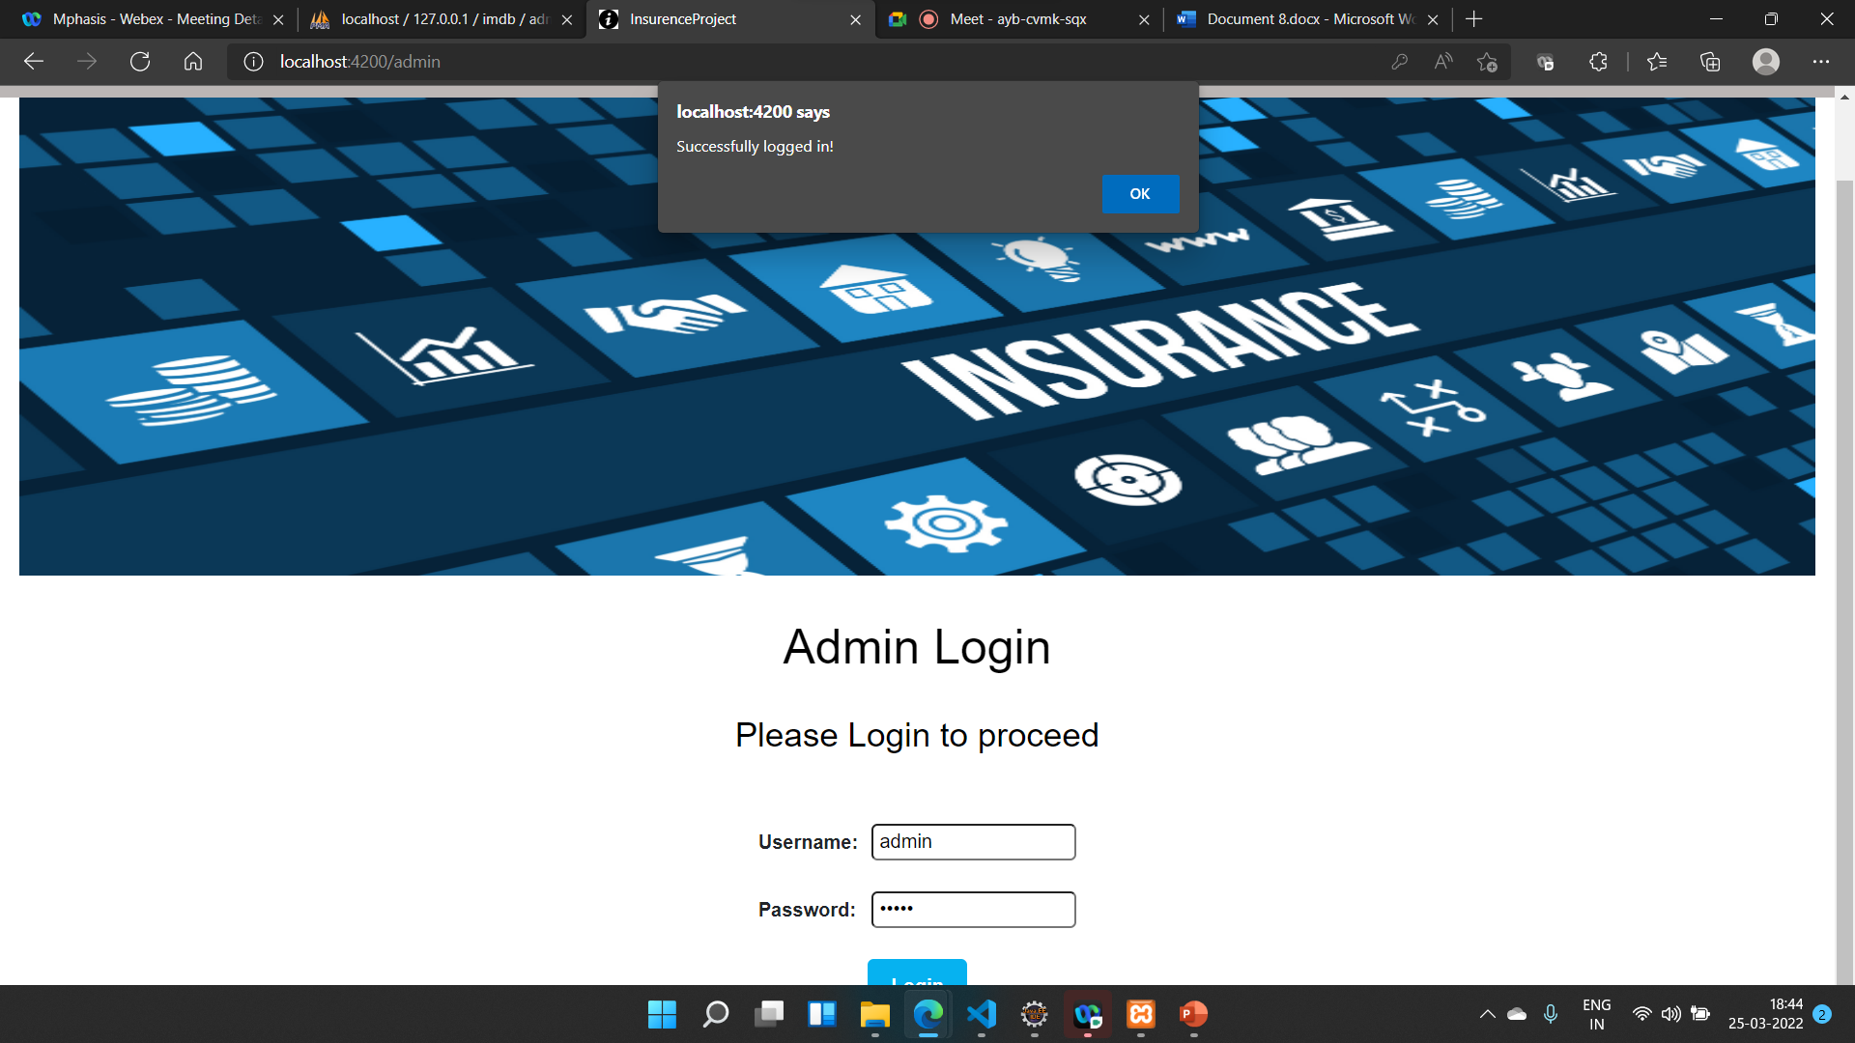

Slide 22
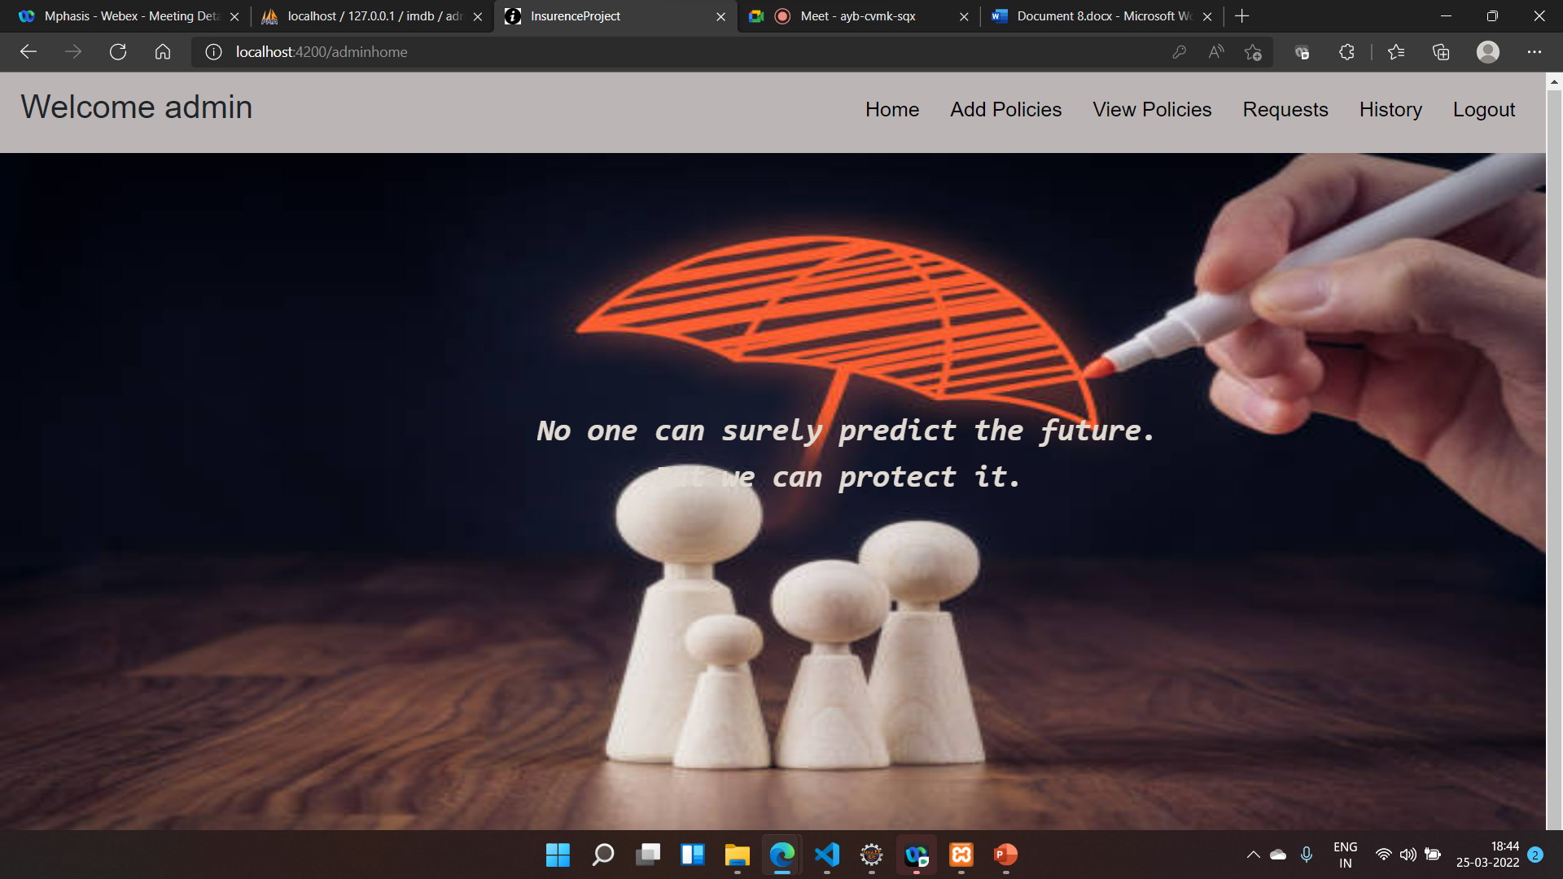

Slide 23
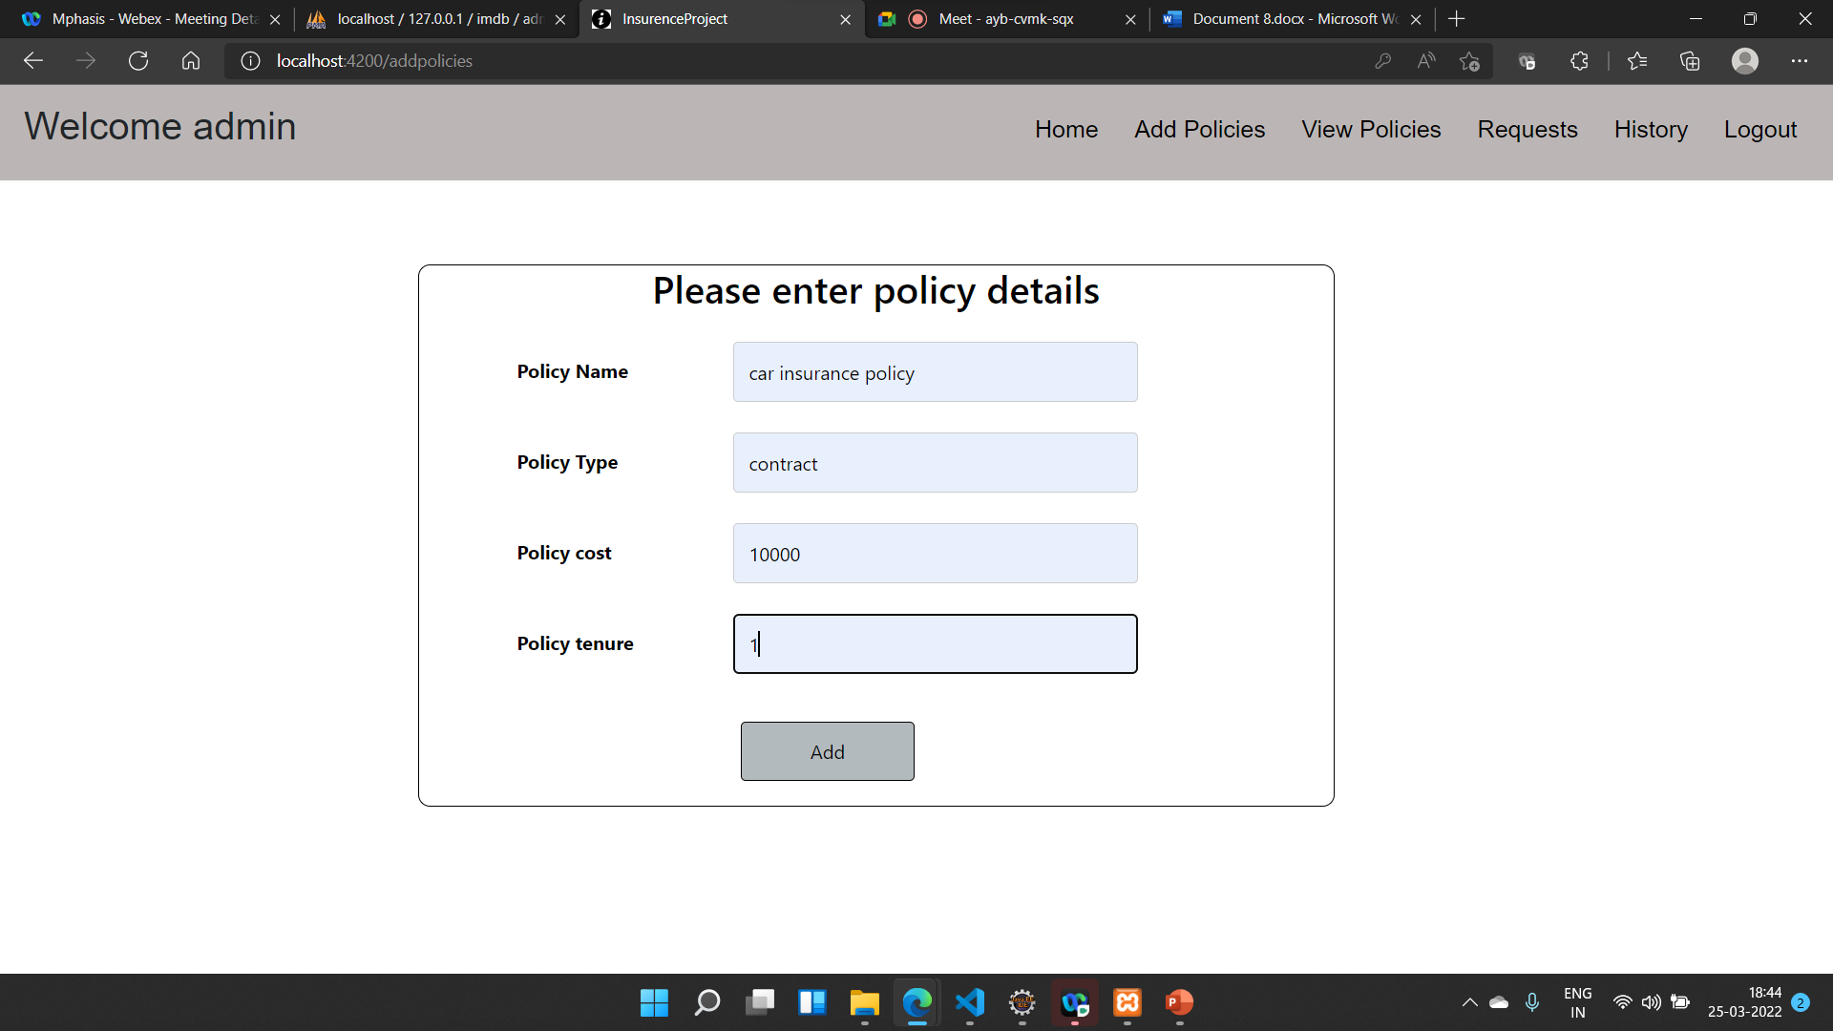

Slide 24
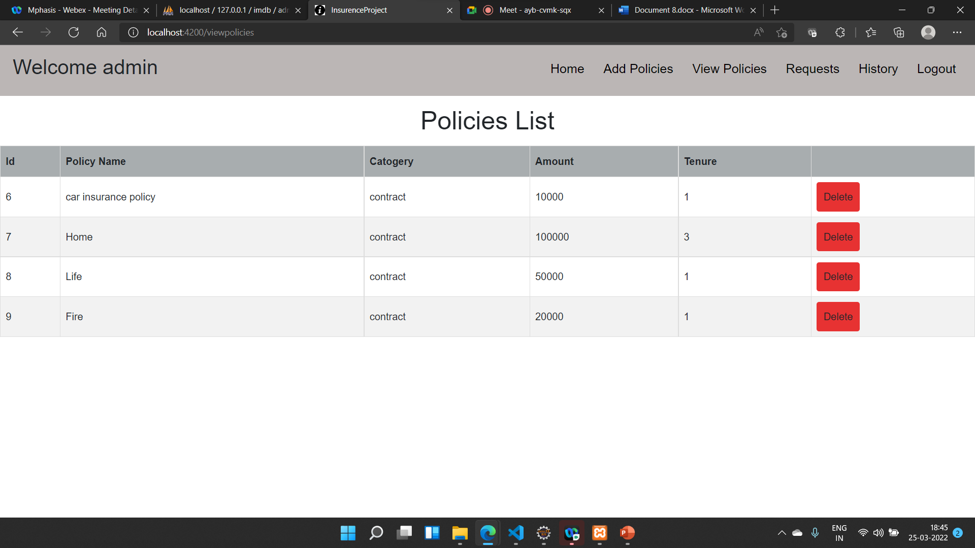

Slide 25
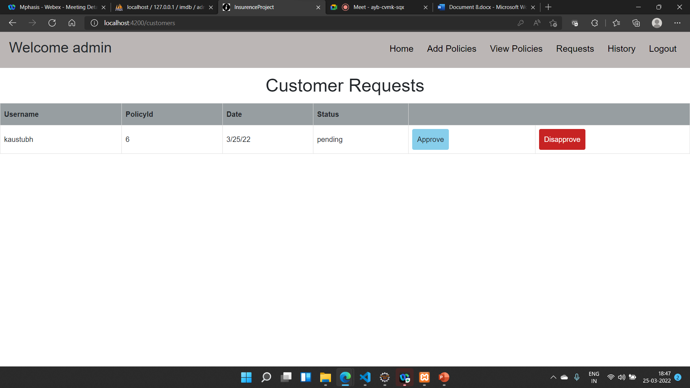

Slide 26
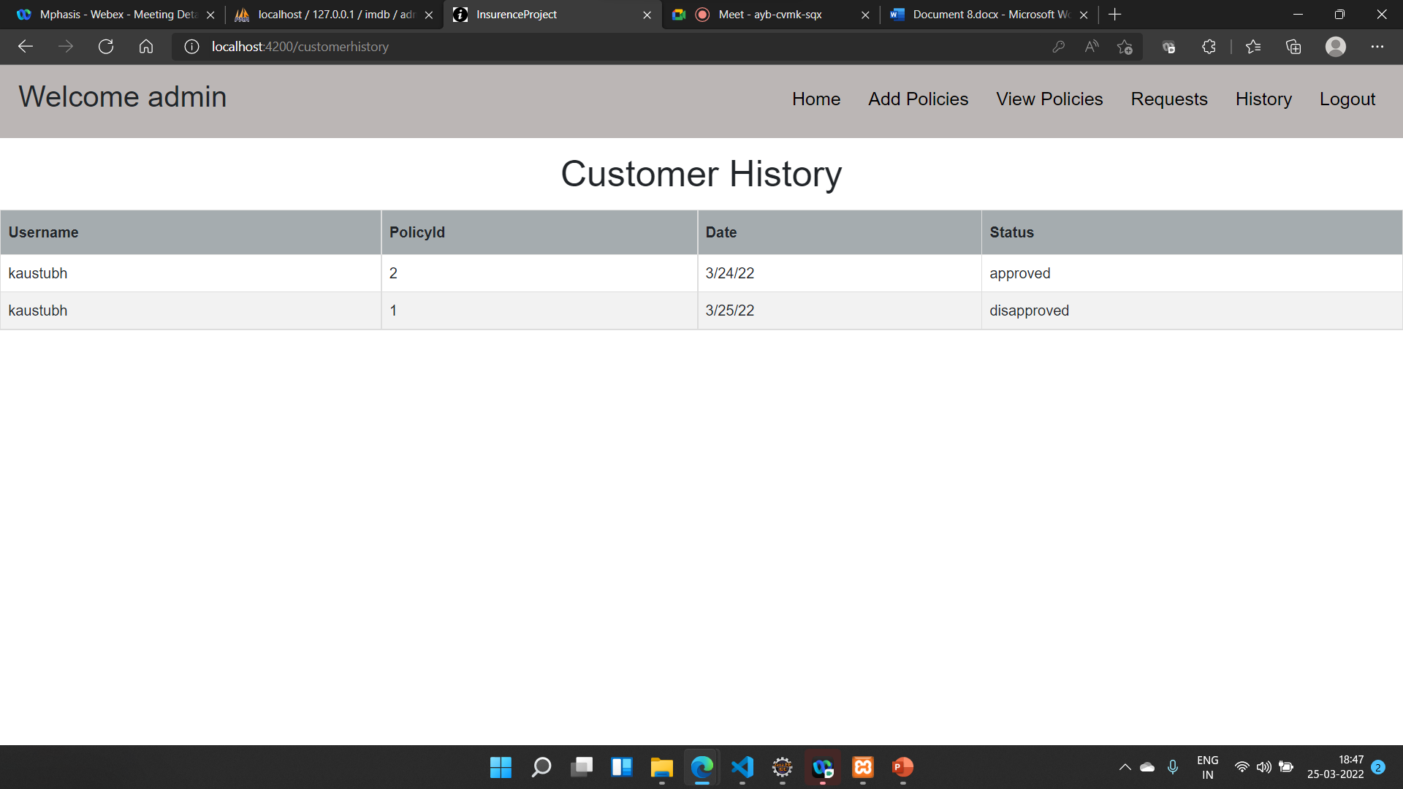

Slide 27
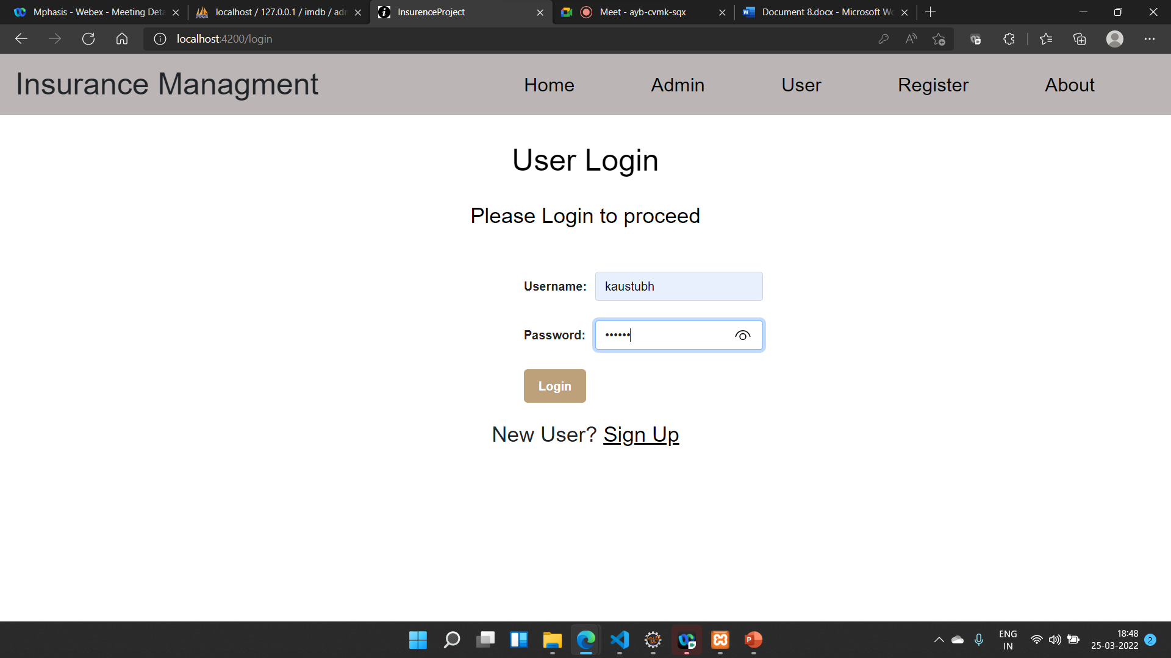

Slide 28
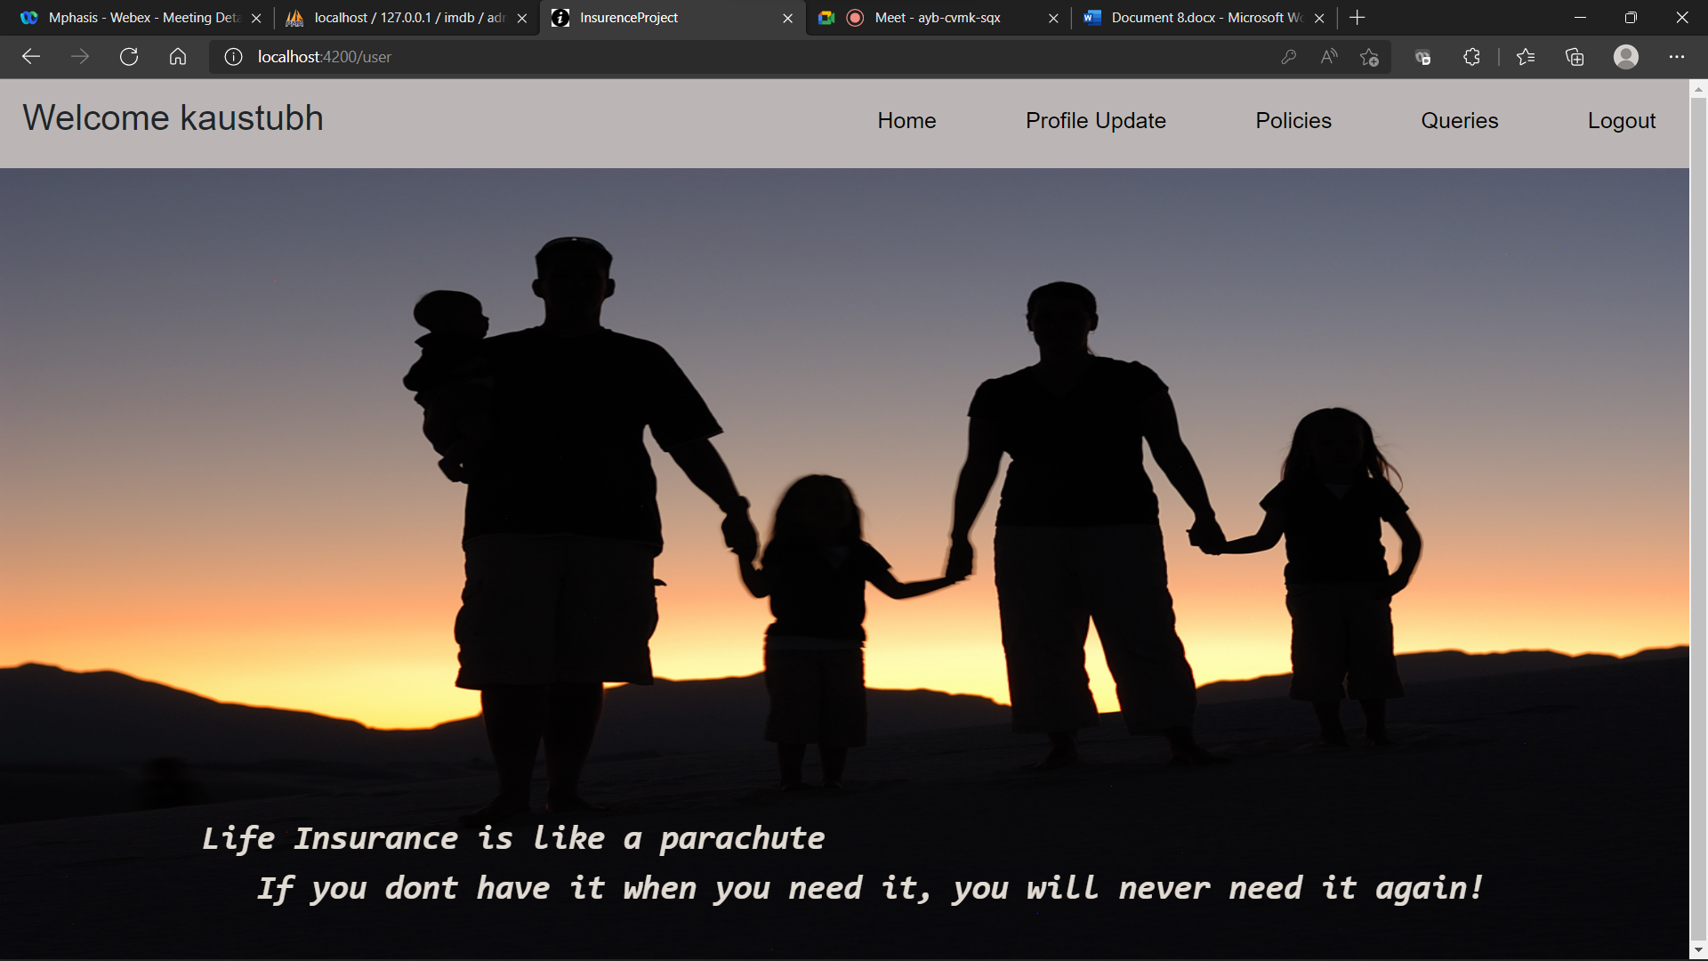

Slide 29
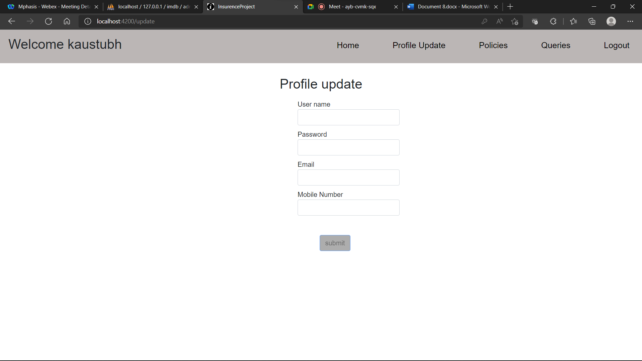

Slide 30
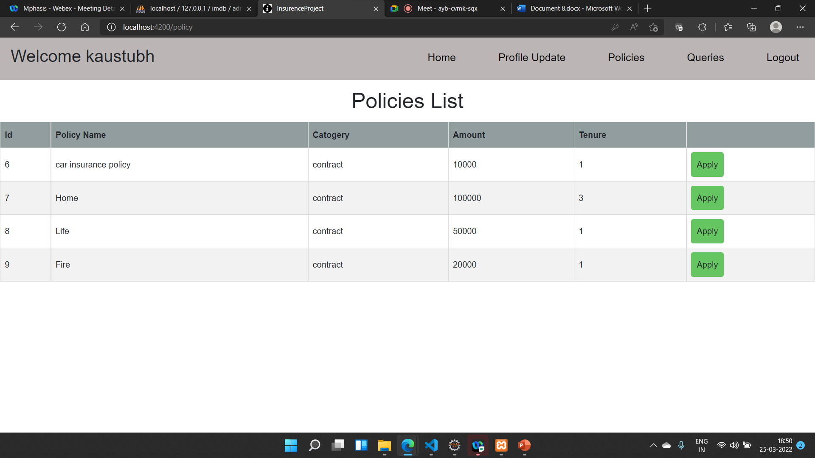

Slide 31
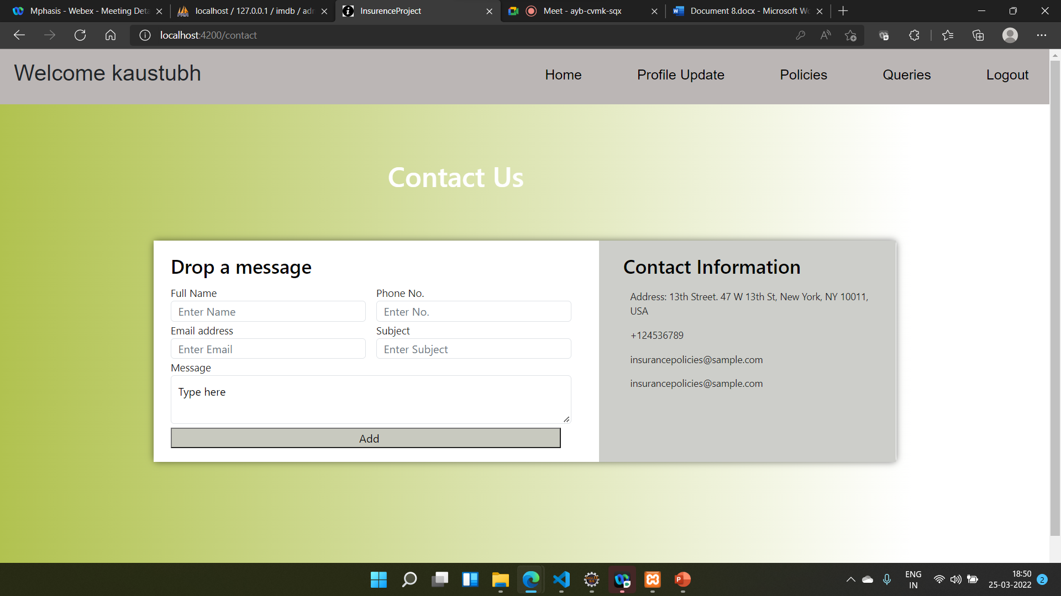

Slide 32
CONCLUSION
By using this application, Insurance organizations will be able to reach the customers directly.
The customers can easily check with the various policies, compare them and enroll to the desired one.
This helps to increase business.

Slide 33
THANK YOU

